Slide 1

A MINI PROJECT ON RESTAURANT MANAGEMENT SYSTEM
Submitted by
SAKSHI JADHAV (36)
PRANALI KAPSE (25)
UNDER THE GUIDANCE OF
Prof. MITRAKSHI PATIL
Department Of Computer Science and Engineering
Saraswati Education Society’s
SARASWATI COLLEGE OF ENGINEERING
Kharghar, Navi Mumbai
(Affiliated to University Of Mumbai)
Academic Year : 2021-22

Slide 2
ROADMAP
INTRODUCTION
PROBLEM STATEMENT
OBJECTIVE
SOFTWARE REQUIRED
ALGORITHM
FLOWCHART
BLOCK DIAGRAM
SNAPSHOTS
FUTURE MODIFICATIONS
CONCLUSION
REFERENCE

Slide 3
INTRODUCTION
The project “RESTAURANT MANAGEMENT SYSTEM” is software for monitoring and controlling the transactions in the restaurant.
Restaurant Management System is a window application designed to help users maintain and organize restaurant. The system processes the transactions and resulting data. Reports will be generated from these data which help the manager to make appropriate business decisions for restaurant.

Slide 4
PROBLEM STATEMENT
Restaurant Management system, this system basically runs between customers and management in a restaurant. The customer interacts with generally one waiter and places their order, while the waiter takes multiple customers in a day. Once the order is prepared the runner uses the invoice to serve the food. The waiter usually asks again if the customers want to order anything more, this process can go on till the customer decides he does not want any more food. The order is essentially the bill generated in the end by the restaurant for the customer. Now we know the customer, waiter and invoice will be present in the order table.

Slide 5
OBJECTIVE
Based on the problems stated above, the objectives of the project are :
To develop ordering and reservation system in restaurants.
To develop use interface for online restaurant management system
To provide online menu information for customer as well as for the manager.

Slide 6
SOFTWARE REQUIRED
NETBEANSE IDE 8.2

Slide 7
ALGORITHM
STEP 1 : Start
STEP 2 : Receive the data
STEP 3 :

Slide 8
FLOWCHART

Slide 9
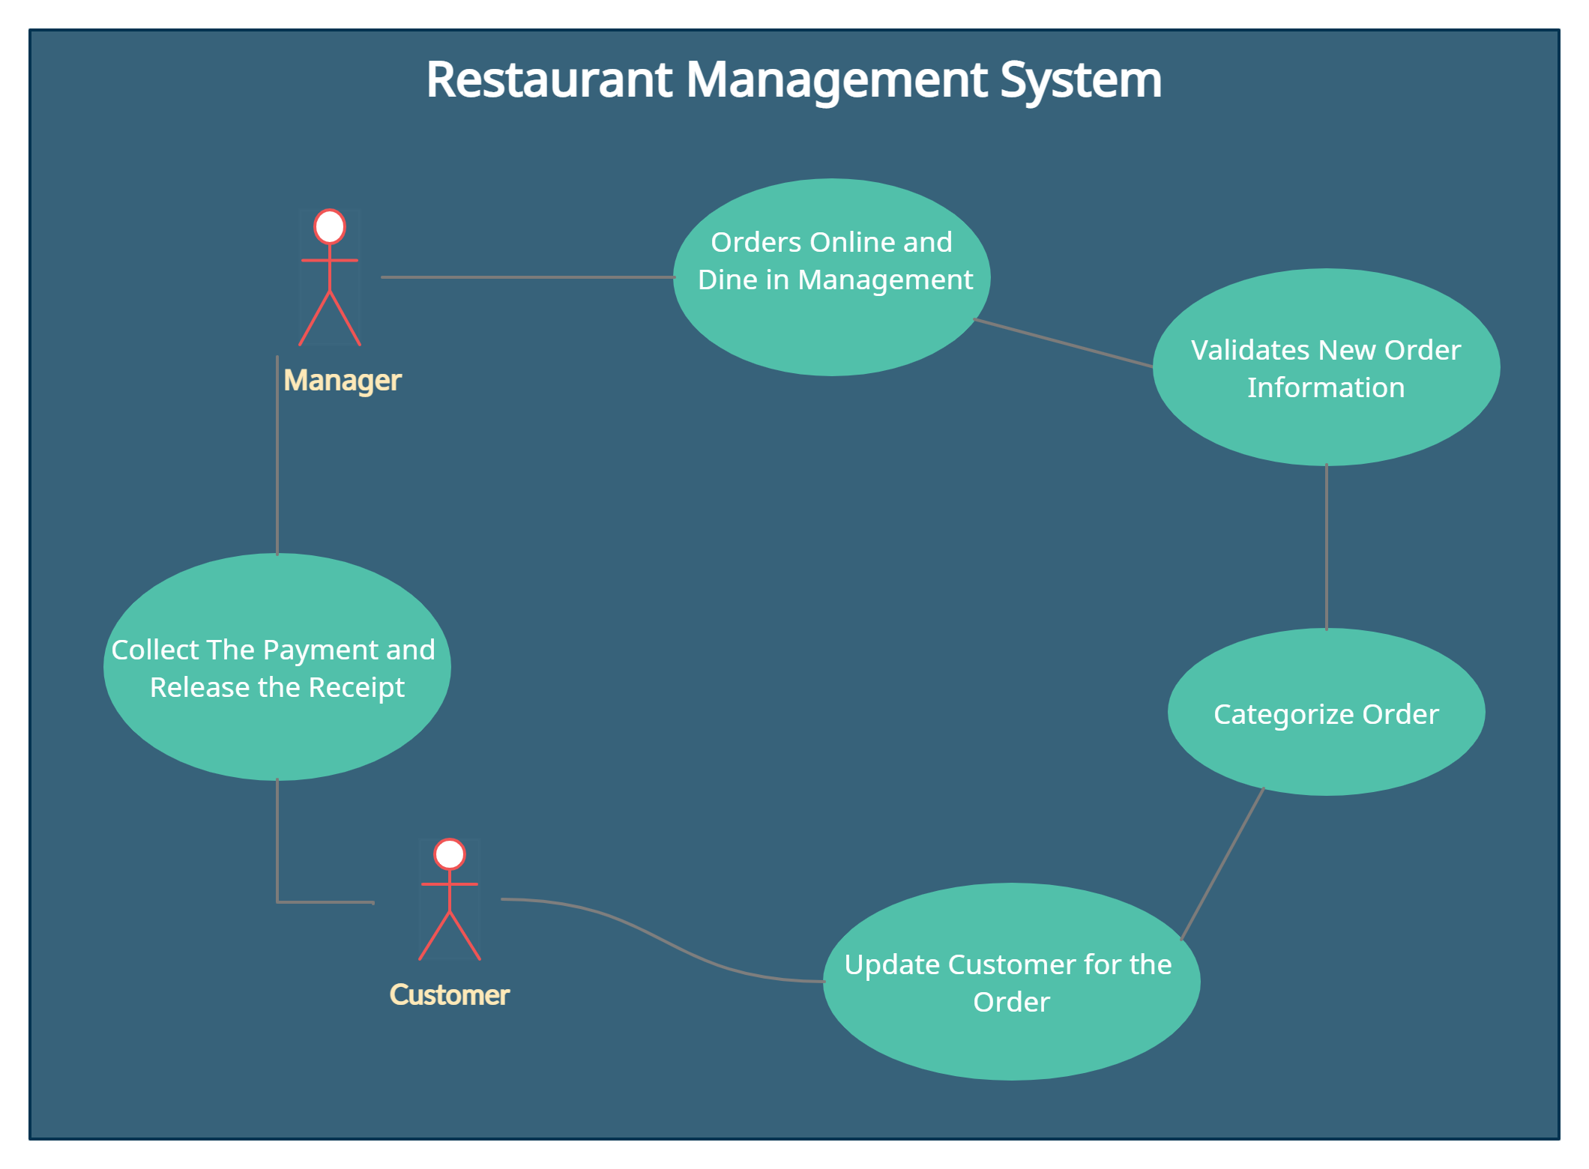
BLOCK DIAGRAM

Slide 10
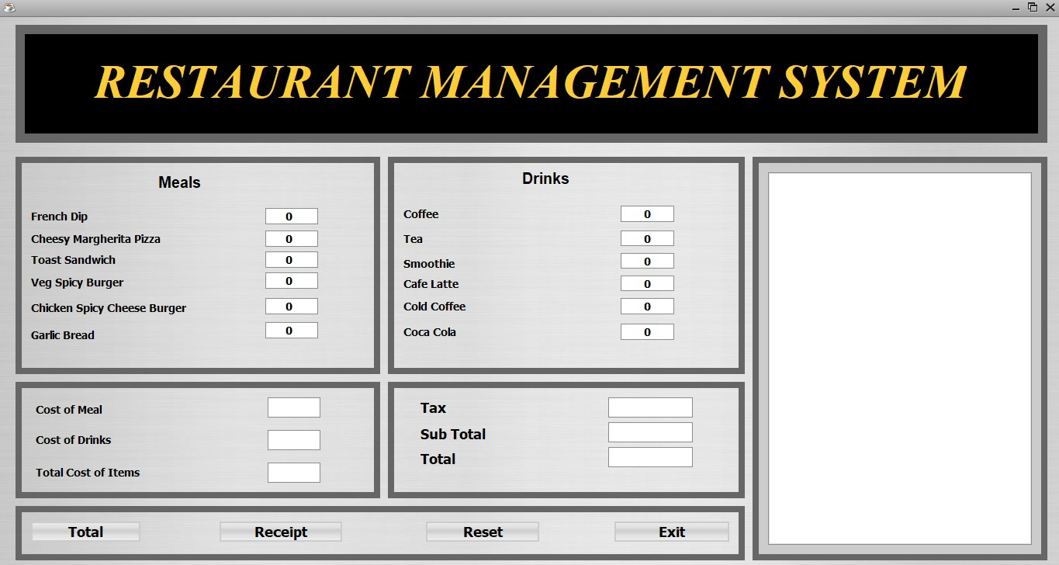
SNAPSHOTS
Main Window

Slide 11
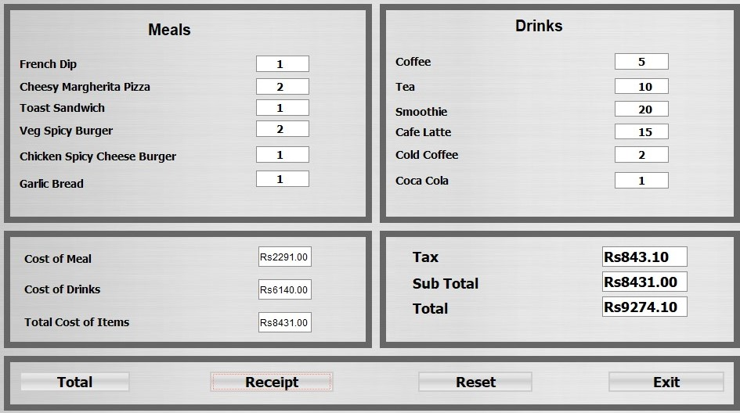
Order Food

Slide 12
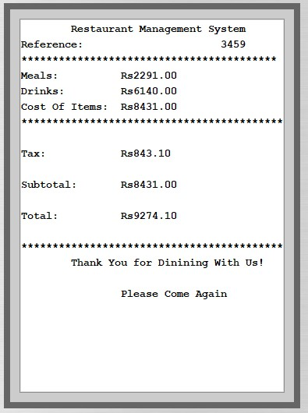
Invoice

Slide 13
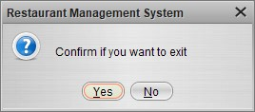
Confirmation for EXIT

Slide 14
FUTURE MODIFICATIONS
In future the project may contain some modifications few are mentioned :
Customer Interface
Tracking order
Taking orders from third party applications such as Swiggy, Zomato, etc.
Online Payment system
Cloud Integration

Slide 15
CONCLUSION
The outcome of all the time hard work is here. We have a system which takes the necessary choice of the customers according to the filter like category of the food . This is achieved through an easy to use graphical interface menu options. The users can add any number of items to the cart from any of the available food Categories.
Customer according to the choice pay bill via cash or debit card or credit card method. Hence all the process works perfect, full filling of demand.

Slide 16
REFERENCE
Github
JAVA The Complete Reference (Seventh Edition)
Stackoverflow.com

Slide 17
THANK YOU

